Slide 1
Key population-led health services: Optimizing prevention and care People who inject drugs: Our needs matter when getting us into services
Svitlana Moroz
Eurasian Women’s Network on AIDS
25 July 2018

Slide 2
2016 Political Declaration on Ending AIDS
services delivered through community channels to reach 30%,
investment in social enablers, including advocacy, political mobilization, law reform, human rights, public communication,
stigma reduction - to account for 6% of global AIDS investments

Slide 3
HIV and People who use drugs in Eastern Europe and Central Asia
42% of new HIV infections in the region in 2015.
HIV prevalence among PWID ranges from 8.5% in Kazakhstan to 25.1% in Belarus,
has reached over 60% in several Russian industrial cities.
Notes:
People who inject drugs (PWID) have long experienced a significant epidemiological burden of HIV in EECA, accounting for
UNAIDS. 2017. Ending AIDS. Progress towards the 90–90–90 targets. Geneva: UNAIDS.
Russian Central Scientific Research Institute of Epidemiology. 2017. Results of the Bio-Behavioural Study of HIV Infection among High Behavioural Risk Groups (IDU, MSM, CSW). Analytic Note. Moscow: Russian Central Scientific Research Institute of Epidemiology.

Slide 4
HIV and Women Who Use Drugs in EECA
In 2016, 14% of all HIV cases reported in Kazakhstan were among women who use drugs, yet there is no population size estimate for them in the country, so more sophisticated epidemiological calculations remain impossible.
In Russia alone, the unofficial number of PWUD is 1.7 million. It can be assumed that approximately 425,000 PWUD in Russia are women. Assuming that an estimated 57% of them are HIV-positive could potentially indicate that over 242,000 women who inject drugs are living with HIV.
Notes:
Formal response to the Fund of Women living with HIV, Kazakhstan dated by October 27, 2017 provided by the Republican Center for AIDS Prevention and Control of the Ministry of Health and Social Development of the Republic of Kazakhstan http://www.ewna.org/wp-content/uploads/2018/04/Letters_Kazakhstan.pdf
UNODC. 2012. World Drug Report.
According to studies conducted in Europe, the proportion of women among the so-called problem drug users (i.e. mainly injecting drug users) stands at about 25%. Women’s voices — experiences and perceptions of women facing drug problems. EMCDDA, Lisbon, May 2009.
Dzjuba, O., Zhilka, N., Orlova, O. 2015. The Analisys of the HIV Mother-to-Child Transmission. Newsletter of Socila Hygene and Public Health in Ukraine. Volume 2 (64)

Slide 5
Vertical transmission and women who use drugs
Ukraine, 2013

Slide 7
Enabling Environment for PUD
Build safe environment – decriminalisation of drug use, sex work, HIV transmission
Develop capacity and provide resources to become human rights defenders, to meet or assemble peacefully, to form, join, participate in and to communicate with non-governmental organizations, associations, groups, or intergovernmental organizations
The existing repressive laws and structural violence prevent PUD from participating in peaceful activities against violations of human rights and fundamental freedoms and demand from the governments to take all necessary measures to ensure the protection by the competent authorities

Slide 8
Service delivery for PWID
Location
Time, working hours
Safety
Confidentiality
Voice and Engagement of People who use drugs
Gender
Integration, including ART, TB, OST treatment/substance use literacy, SRHR

Slide 9
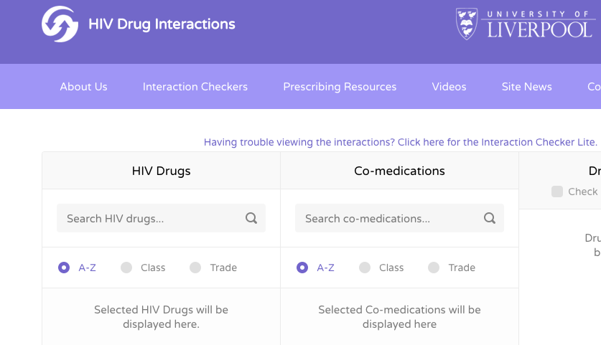
Tool to Check Drugs Interactions

Slide 10
HIV interventions for PUD
must not only focus on individual behavior change
but also address PUD vulnerability, such as:
criminalization and other punitive laws, bylaws, and practices
stigma and discrimination
poverty; housing instability
violence and harassment
and limited access to health, social, and financial services.
must be grounded in the best possible data for shrewd decision-making.
PUD must to be engage in the planning, implementation, and monitoring of national HIV responses

Slide 11
Sample slide 3

